Slide 1
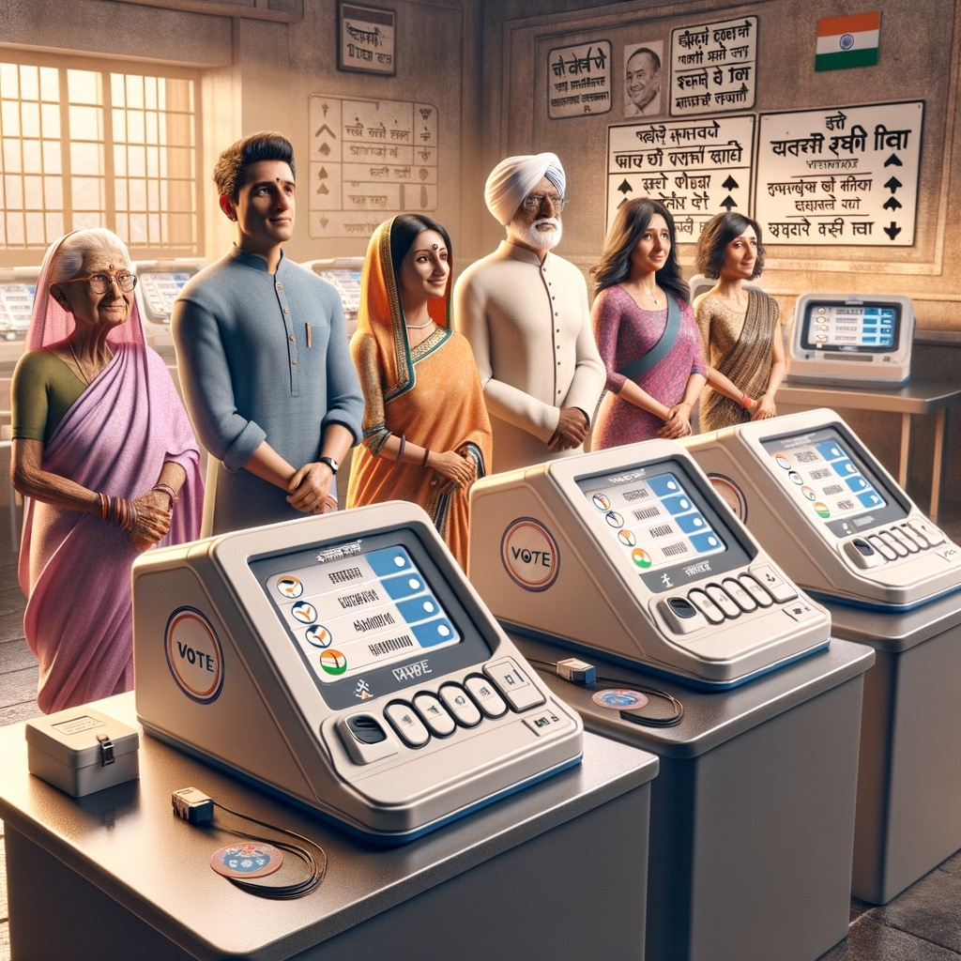
VOTING MACHINE
GROUP-5
S. Sai Lohitha(BU21EECE0100103)
B. N. Raksha(BU21EECE0100552)
B. Jagadeeshwar(BU21EECE0100177)
Mohan PS(BU21EECE0100387)
P. Meghana(BU22EECE0100339)
Under the guidance of
DR. ARUN KUMAR MANOHARAN

Slide 2
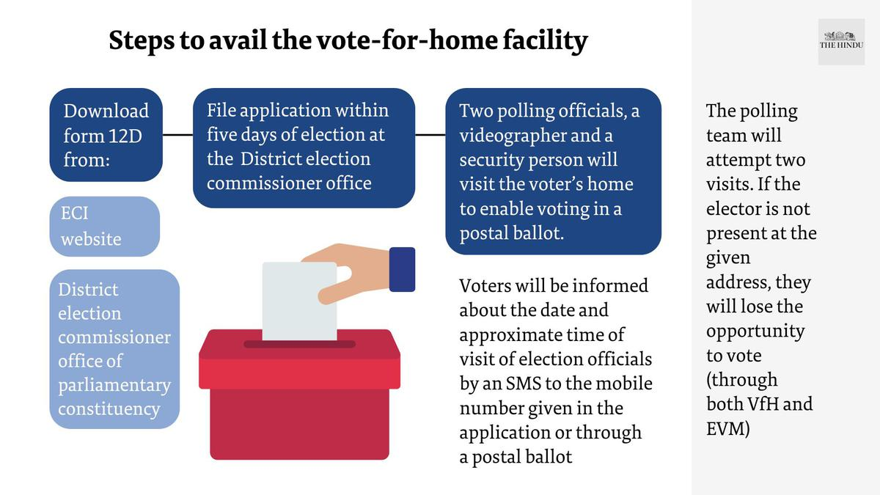
Voting Procedure in India
Voting in India began with universal adult suffrage in 1952 after
independence. Here's a concise rundown of the process:
1. Preparation: The Election Commission maintains electoral rolls.
2. Registration: Citizens over 18 enroll as voters with proof of identity and residence.
3. Constituencies: India is divided into areas, each electing one representative to the Lok Sabha.
4. Candidates and Campaigning: Political parties nominate candidates who campaign to persuade voters.
5. Election Day: Voters go to polling stations, present ID, and cast votes using ballot papers or electronic voting machines (EVMs).
6. Vote Counting: Votes are tallied, winners declared, and the majority party forms the government.
7. Election Commission Oversight: The Election Commission ensures fair elections, monitors campaigns, and enforces electoral laws.
8. Regular Elections: General elections occur every five years for the Lok Sabha and state legislative assemblies, along with periodic local body elections.

Slide 3
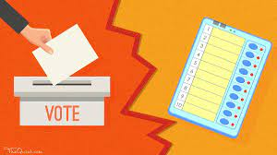
Safeguards Against Voter Fraud in Indian Elections
To prevent fraud votes, India implements several safeguards in its electoral process. These include strict voter registration procedures requiring valid identification, the use of indelible ink to mark voters after casting their ballots, and the widespread use of tamper-proof Electronic Voting Machines (EVMs). Polling stations are secured, and the entire process is overseen by election officials and party representatives to maintain transparency. After voting concludes, votes are counted meticulously, with legal recourse available for any allegations of malpractice. These measures collectively aim to uphold the integrity of the electoral system and ensure that only legitimate votes are counted.
Both ballot boxes and EVMs offer safeguards against fraud votes, albeit through different mechanisms. While ballot boxes provide a transparent and manually verifiable process, EVMs offer efficiency and reduced human error. The choice between the two depends on factors such as technological infrastructure, voter confidence, and the specific needs of the electoral system. Ultimately, robust safeguards, regardless of the voting method, are essential to ensure the integrity and fairness of elections.

Slide 4

Strengthening the Integrity of Voter Identification Through Fingerprint Authentication

Slide 5
Introducing Fingerprint Authentication: Enhancing Electoral Integrity in India
Fingerprint authentication offers a robust solution to combat voter fraud and enhance the integrity of the electoral process in India. By implementing fingerprint sensors at polling stations, voters would be required to authenticate their identity before casting their votes. This biometric authentication method ensures that only legitimate voters can participate in the electoral process, significantly reducing the risk of fraud votes.
Here's how the implementation would work:
1. Enrollment Process: Before elections, eligible voters would need to enroll their fingerprints with the Election Commission database. This process would involve capturing fingerprints using secure and reliable technology to create a unique biometric identifier for each voter.
2. Voter Verification: On election day, voters would approach the polling station and present their identification documents, as usual. In addition to this, they would need to place their finger on the fingerprint sensor for verification.
3. Authentication: The fingerprint sensor would compare the voter's fingerprint with the stored biometric data in real-time. If the fingerprints match, the voter would be allowed to proceed with casting their vote. Otherwise, they would be denied access, preventing unauthorized individuals from voting.
4. Data Security: It's crucial to ensure the security and privacy of voter biometric data. Robust encryption and data protection measures must be implemented to safeguard this sensitive information from unauthorized access or misuse.
5. Accessibility Considerations: Adequate provisions should be made to ensure that the fingerprint authentication system is accessible to all voters, including those with disabilities or special needs.

Slide 6
Introducing fingerprint authentication for enhancing electoral integrity in India presents some challenges and potential disadvantages:
1. Cost and Infrastructure: Implementing fingerprint authentication systems across all polling stations would require significant financial investment and technological infrastructure. This could pose challenges in areas with limited resources or inadequate technological infrastructure.
2. Complexity: Fingerprint authentication adds an extra layer of complexity to the voting process, potentially increasing the time taken for each voter to cast their ballot. This may result in longer queues and delays, especially during peak voting hours.
3. Data Security Concerns: Storing and managing biometric data, such as fingerprints, raises concerns about data security and privacy. There is a risk of unauthorized access, hacking, or misuse of biometric information, leading to identity theft or fraud.
4. Accessibility Issues: Fingerprint authentication may pose accessibility challenges for certain groups, such as elderly voters or those with disabilities. Ensuring that the system is inclusive and accessible to all voters would require additional considerations and accommodations.
5. False Rejections and Errors: Fingerprint authentication systems are not foolproof and may sometimes result in false rejections or errors, where legitimate voters are denied access due to issues with fingerprint recognition. This could disenfranchise eligible voters and undermine the democratic process.
6. Resistance and Trust Issues: Introducing new technology in elections may face resistance from some segments of the population who are skeptical about the reliability and security of electronic systems. Building trust and confidence in fingerprint authentication would require extensive awareness campaigns and transparency from election authorities.

Slide 7

To overcome challenges with fingerprint authentication in Indian elections:
1. Start Small: Begin with pilot programs to test feasibility.
2. Invest in Infrastructure: Allocate resources for tech development.
3. Secure Data: Implement robust security measures for biometric data.
4. Ensure Accessibility: Provide alternative methods for voters with issues.
5. Educate the Public: Conduct awareness campaigns to build trust.
6. Engage Stakeholders: Involve various groups in the process.
7. Establish Regulations: Develop clear legal frameworks.
8. Continuous Improvement: Monitor and adapt systems for efficiency.
This multifaceted approach ensures a balanced implementation of fingerprint authentication, addressing concerns while enhancing electoral integrity.

Slide 8
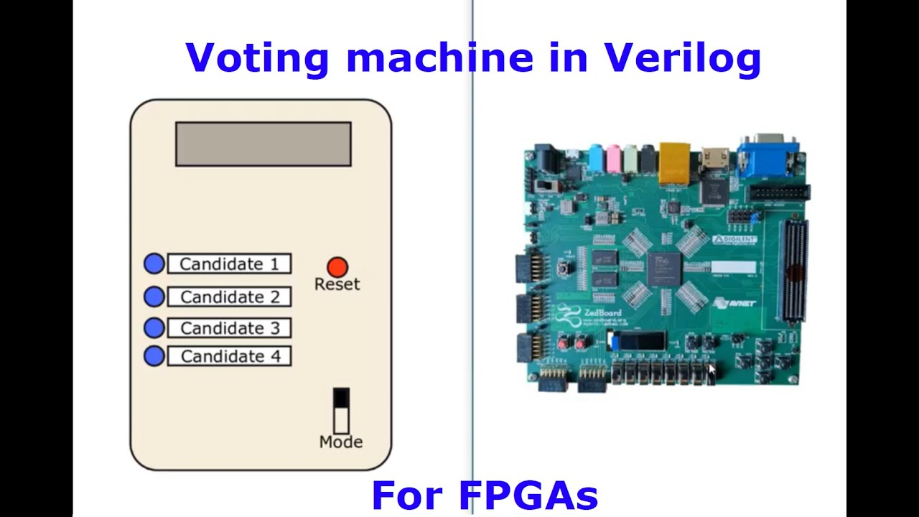
Implementation of voting machine in Xilinx Vivado software using FPGA kit

